Slide 1
A Final level Seminar on Design and Implementation of Asynchronous FIFO using Verilog HDL
Presented by
Y.M Bhavani (11881A0408)
Sowmya Budiga (11881A0445)
Navya Vujini (11881A0427)
K. Bharath (11881A0406)
Under the guidance of
Mr. B. Srikanth
Assistant Professor
Department of Electronics and Communication Engineering
VARDHAMAN COLLEGE OF ENGINEERING

Slide 2
Contents
Introduction
Block Diagram
Output waveform
Advantages
Applications
References

Slide 3
Introduction
An Asynchronous FIFO Design refers to a FIFO Design where in the data values are written to the FIFO memory from one clock domain and the data values are read from a different clock domain.
They are widely used to safely pass the data from one clock domain to another clock domain
The two clock domains are Asynchronous to each other.

Slide 4
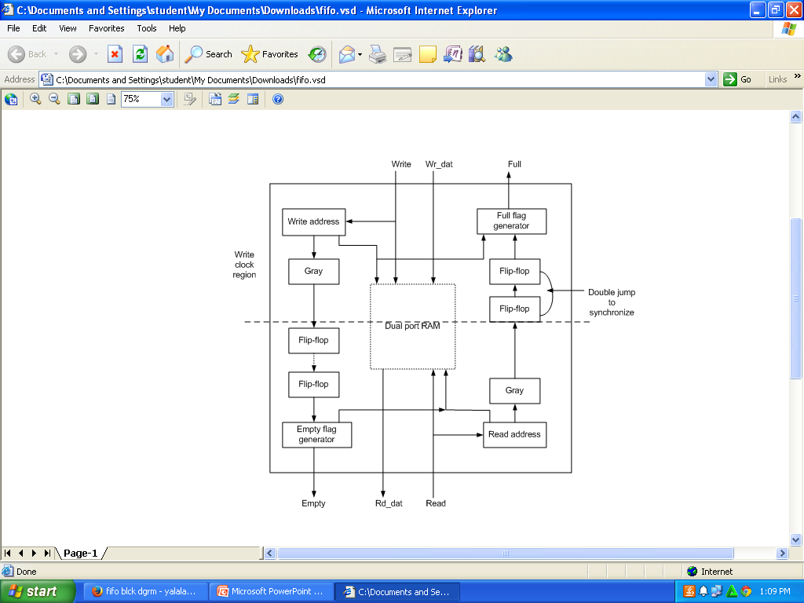
Block Diagram
fig: Asynchronous FIFO

Slide 5
Input data

Slide 6
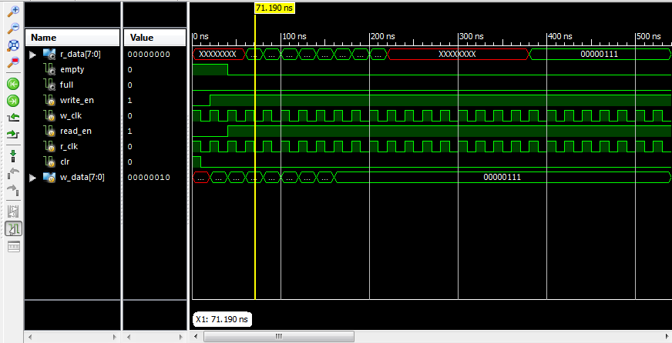
Output Waveform

Slide 7
Conclusion
It is an efficient technique to implement a high-speed asynchronous FIFO, using dual-port RAMs addressed by Gray counters.
It has high reliability, re-configurability, low development cost and consumes low power.

Slide 8
References
Van de Goor, AI, Schanstra I. Zorian Y, Fault Models and Tests for Ring Address.
Nobutaro Shibata.maynmi watanabe. A current-sensed high speed and low-power first in first out memory using a wordline/bitline-swapped dual-port sram cell. IEEE Journal of Solid State Circuites. VOL 37, NO. 6, JUNE 2002.

Slide 9
THANK YOU

